Slide 1
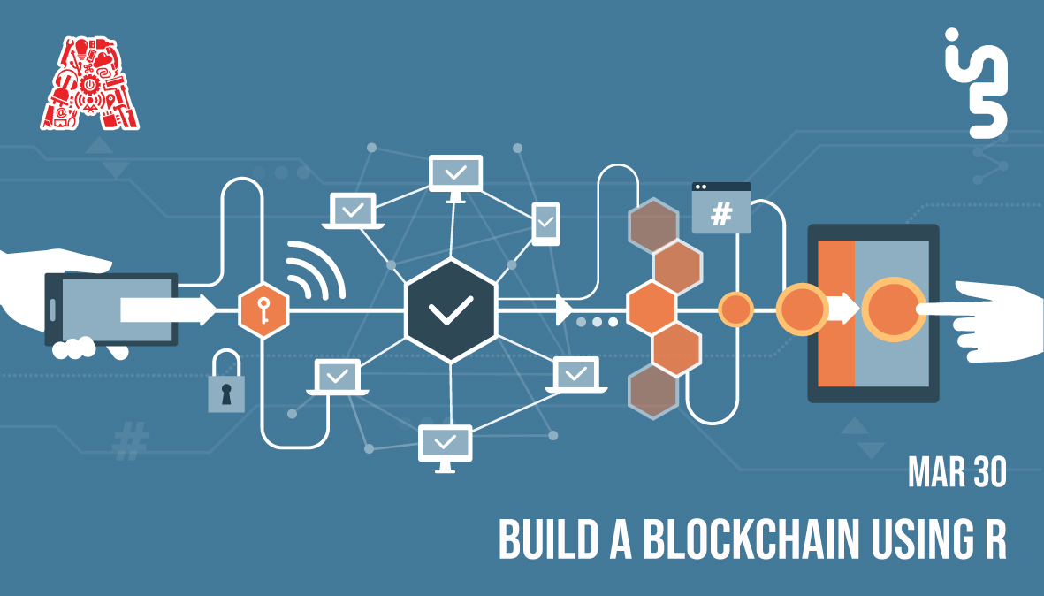

Slide 2
About the Assembly
A smart lab based out of In5 since Dec 2014
Over 250 free workshops done
ASSEMBLY: HACK - Embedded systems, iOT and hardware
ASSEMBLY: CODE - Software projects - APIs, frameworks, apps
Age range: 16-60 - students, professionals, entrepreneurs
Focus on smart technology and practical applications
Forum: members.theassembly.ae

Slide 3
TAG US ON OUR SOCIAL MEDIA
FACEBOOK
TWITTER
INSTAGRAM
YOUTUBE
The Assembly (@MakeSmartThings)
@MakeSmartThings
@MakeSmartThings
The Assembly

Slide 4

Overview
TOPICS:
What Is R and why to use it?
Companies using R
Introduction to R language
Flow control in R
Functions in R
Object and class in R
Data structure in R
Graphs and charts in R
Blockchain

Slide 5


What Is ?
STATISTICAL
COMPUTING

Slide 6
Why Use ?
RELATES TO OTHER LANGUAGES
OPEN SOURCE LANGUAGE
CROSS PLATFORM COMPATIBLE
DATA WRANGLING
EXTREMELY COMPREHENSIVE
STATISTICAL LANGUAGE
DATA VISUALIZATION
MACHINE LEARNING

Slide 7

Companies Using
Advertisement, Economic Forecasting and Big-data statistical modeling.
To help create innovative solutions like IBM Watson.
Data Visualization and Semantic Clustering.
Predict re-booking rates.
Exploratory Data and Experimental Analysis, Big-Data Visualization, Human Resources.
User behaviour, Visualizing infrastructure utilization data, Abnormal login detection, Time series anomaly detection, Forecast package.
Data journalism and Data visualization

Slide 8
Getting started
Install: R( https://cran.r-project.org/bin/ ) & RStudio( https://www.rstudio.com/products/rstudio/download/ )
Installing on Ubuntu using terminal
$sudo apt-get install r-base
$sudo apt-get install gdebi-core
3. Ask for help from the Assembly team if you get stuck with anything!

Slide 9
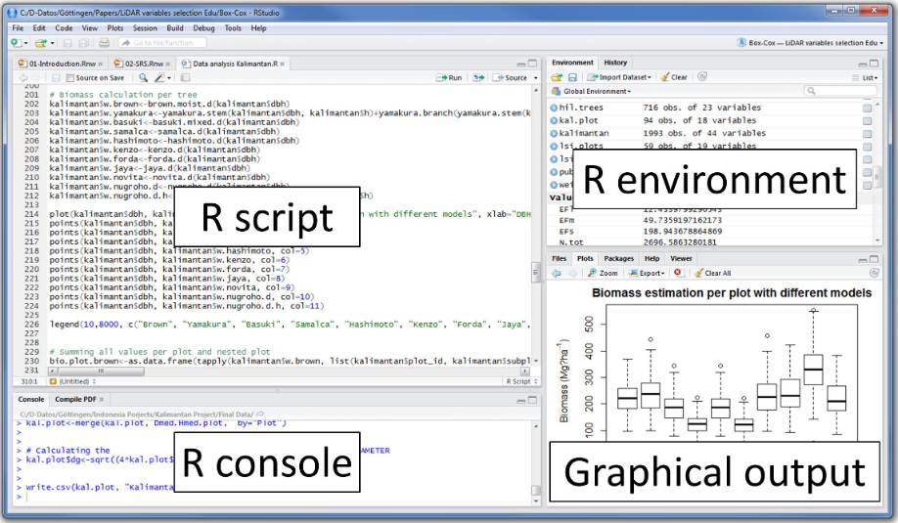
Studio Layout

Slide 10
Basics
Reserved words in R
Type: help(“reserved”) or ?reserved in Console
Identifiers (Variables and constants)
Type: help(“variable.names”) or ?variable.names in Console
Type: help(“constants”) or ?constants in Console
R Operators
Arithmetic Operators
Relational Operators
Logical Operators
Assignment Operators

Slide 11
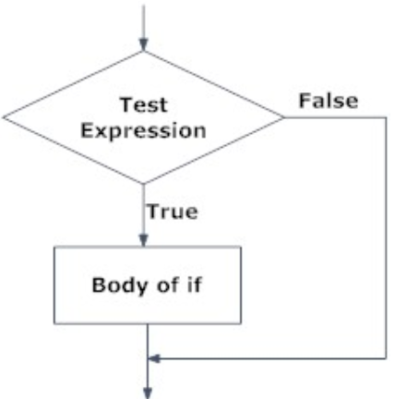
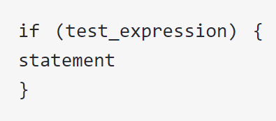
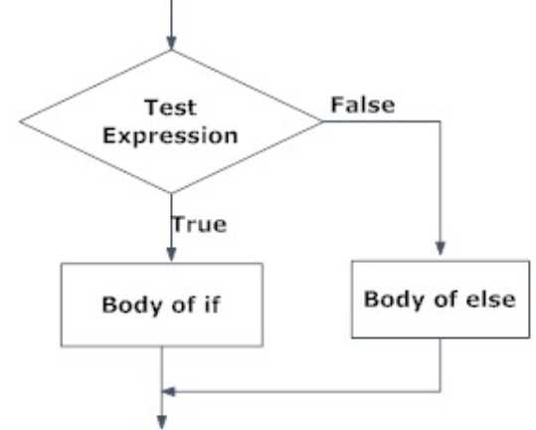
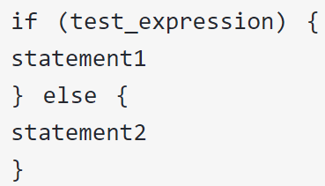
Flow Control
if statement
If…else statement

Slide 12
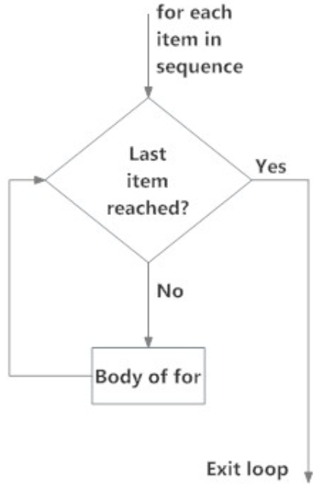
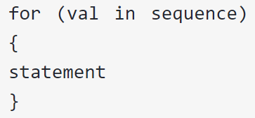
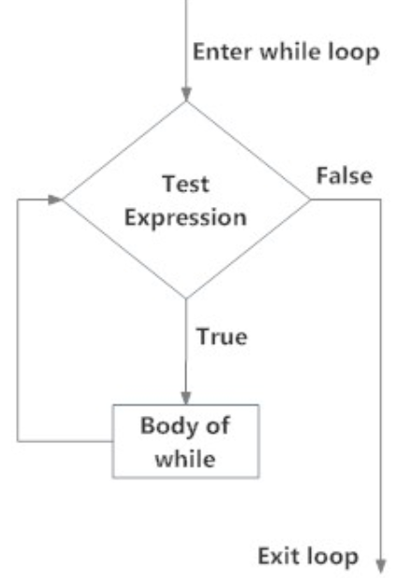
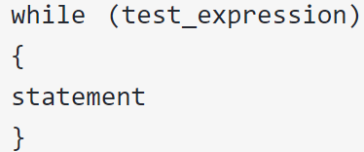
Ifelse() function
for loop
while loop

Slide 13
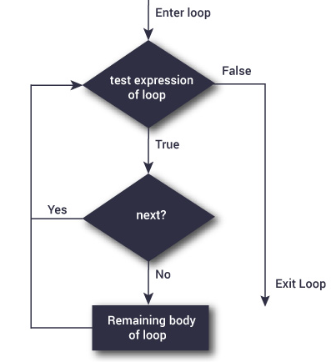
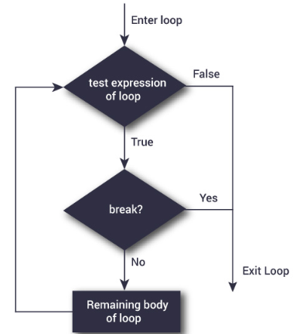
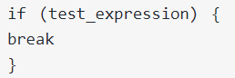
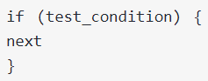
Break and Next Statement

Slide 14
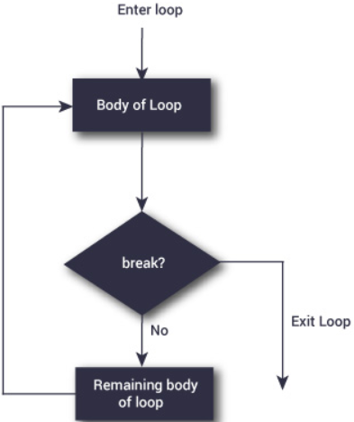
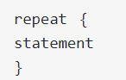
Break and Next Statement

Slide 15
Functions
Defining a function
MyFunction <- function (argument){
#Statement
Return (argument)
}
Calling a function
MyFunction(arg)

Slide 16
Objects And Class
S3 Class
S3 class is somewhat primitive in nature. It lacks a formal definition and object of this class can be created simply by adding a class attribute to it.
S4 Class
S4 class are an improvement over the S3 class. They have a formally defined structure which helps in making object of the same class look more or less similar.
Reference Class
Reference classes are basically S4 classed with an environment added to it.

Slide 17
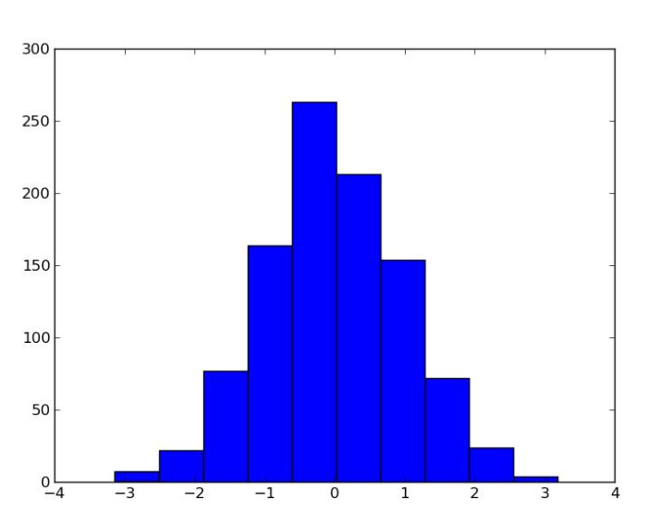
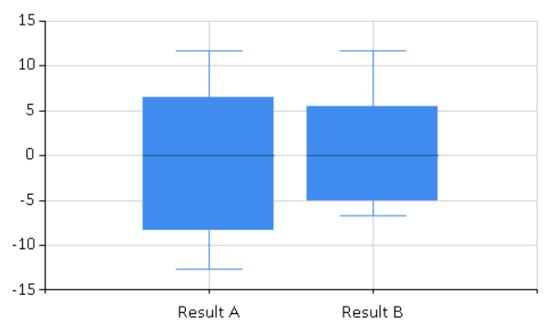
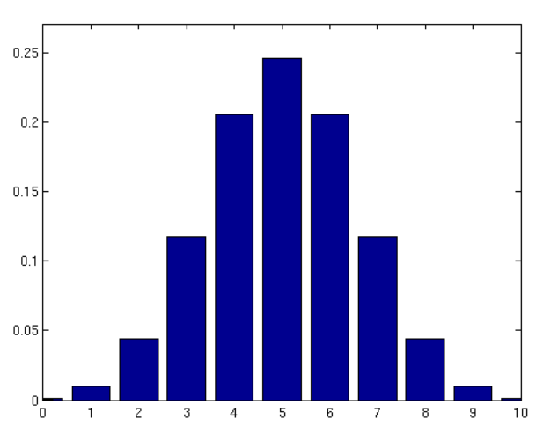
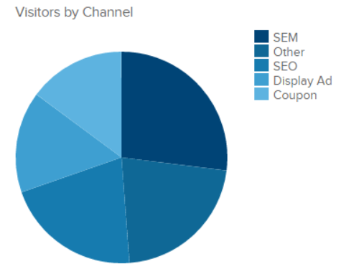
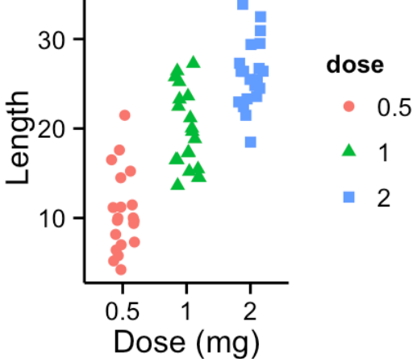
Graphs And Charts
Bar Plot Histogram Pie Chart Box Plot Strip Chart
barplot() hist() pie() boxplot() stripchart()

Slide 18
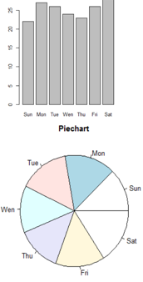
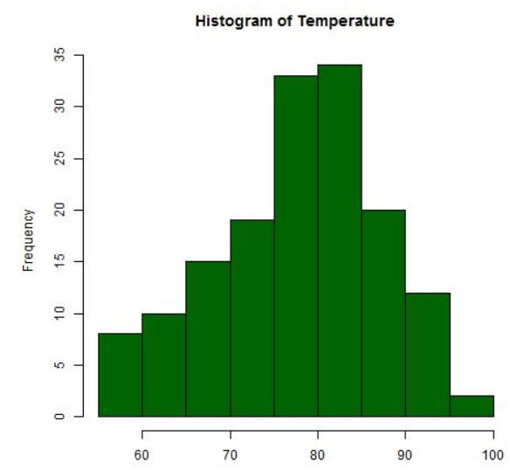
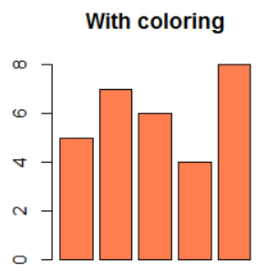
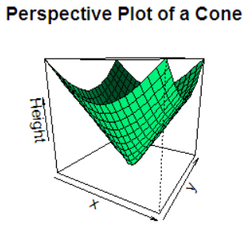
Advance Options
Subplot
Saving Plots
Color Plot
3D Plot
par()
jpeg(),png(),bmp() & tiff()
dev.off()
Col="Name of the color"
persp(x, y, z)

Slide 19

ABOUT

Slide 20
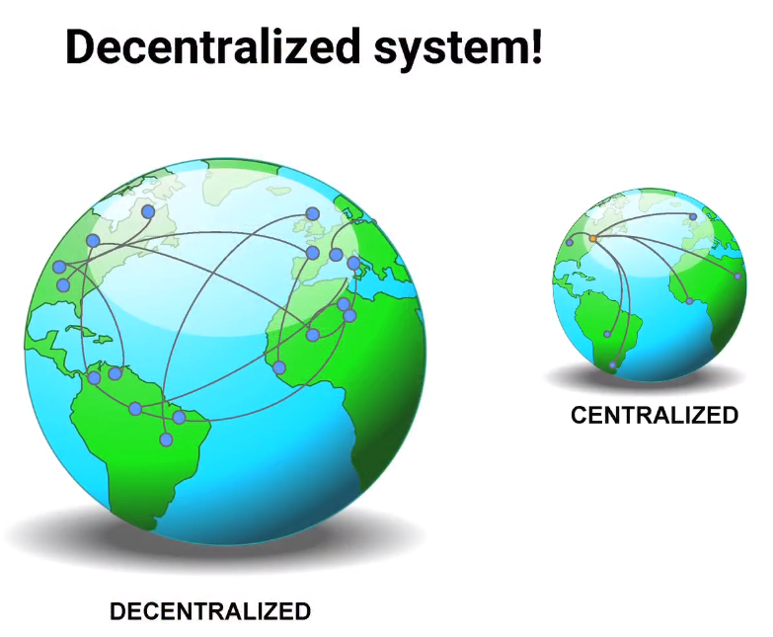

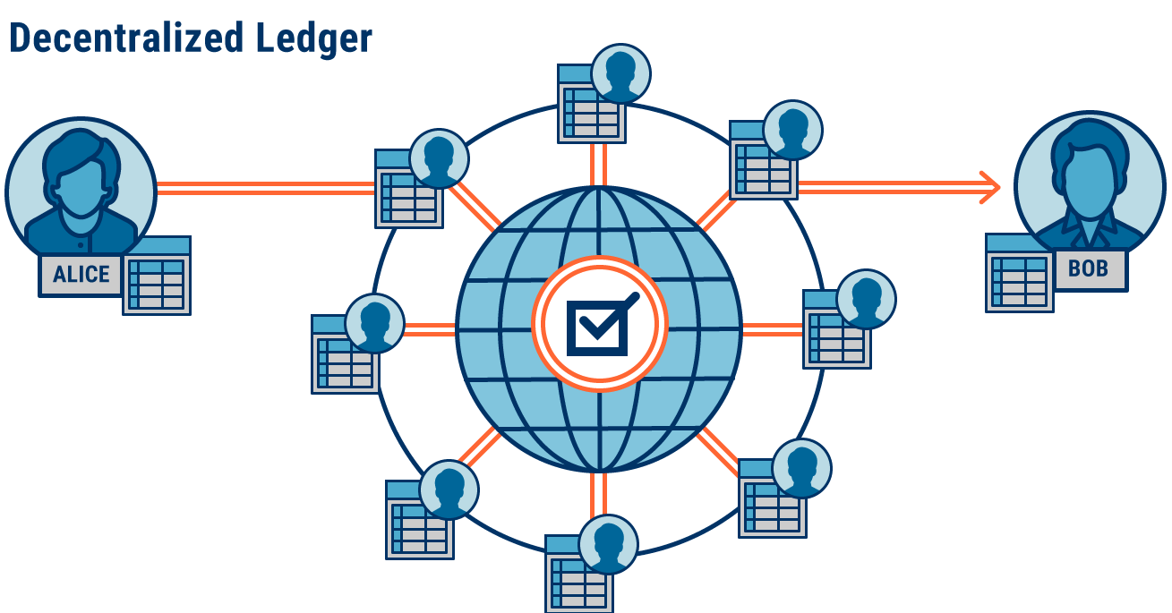


Slide 21







Companies Using blockchain
Enhance cloud service security and for data protection
Product Tracking
Disputes Settling
Storing patient’s medical records for insurance purposes
Enhance the mobility technologies
Tracking Luxury Goods

Slide 22

Blockchain Concept
Data
Hash
Previous Hash

Slide 23
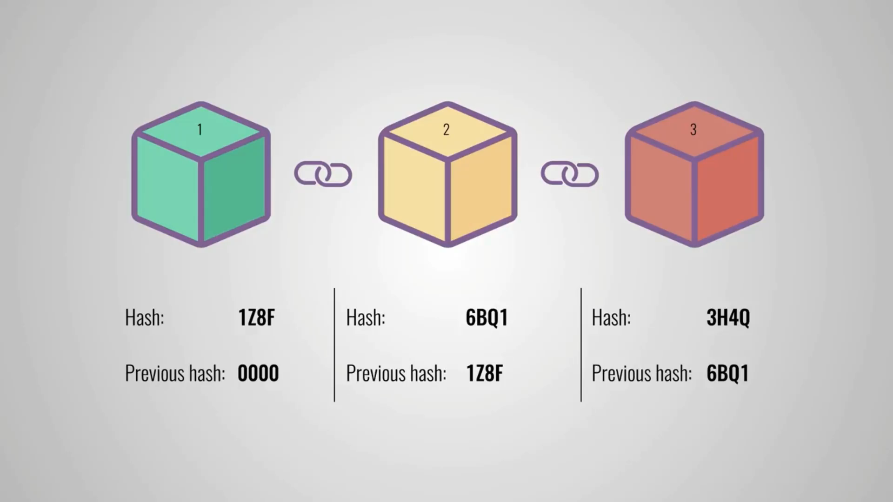
Hash Concept I

Slide 24
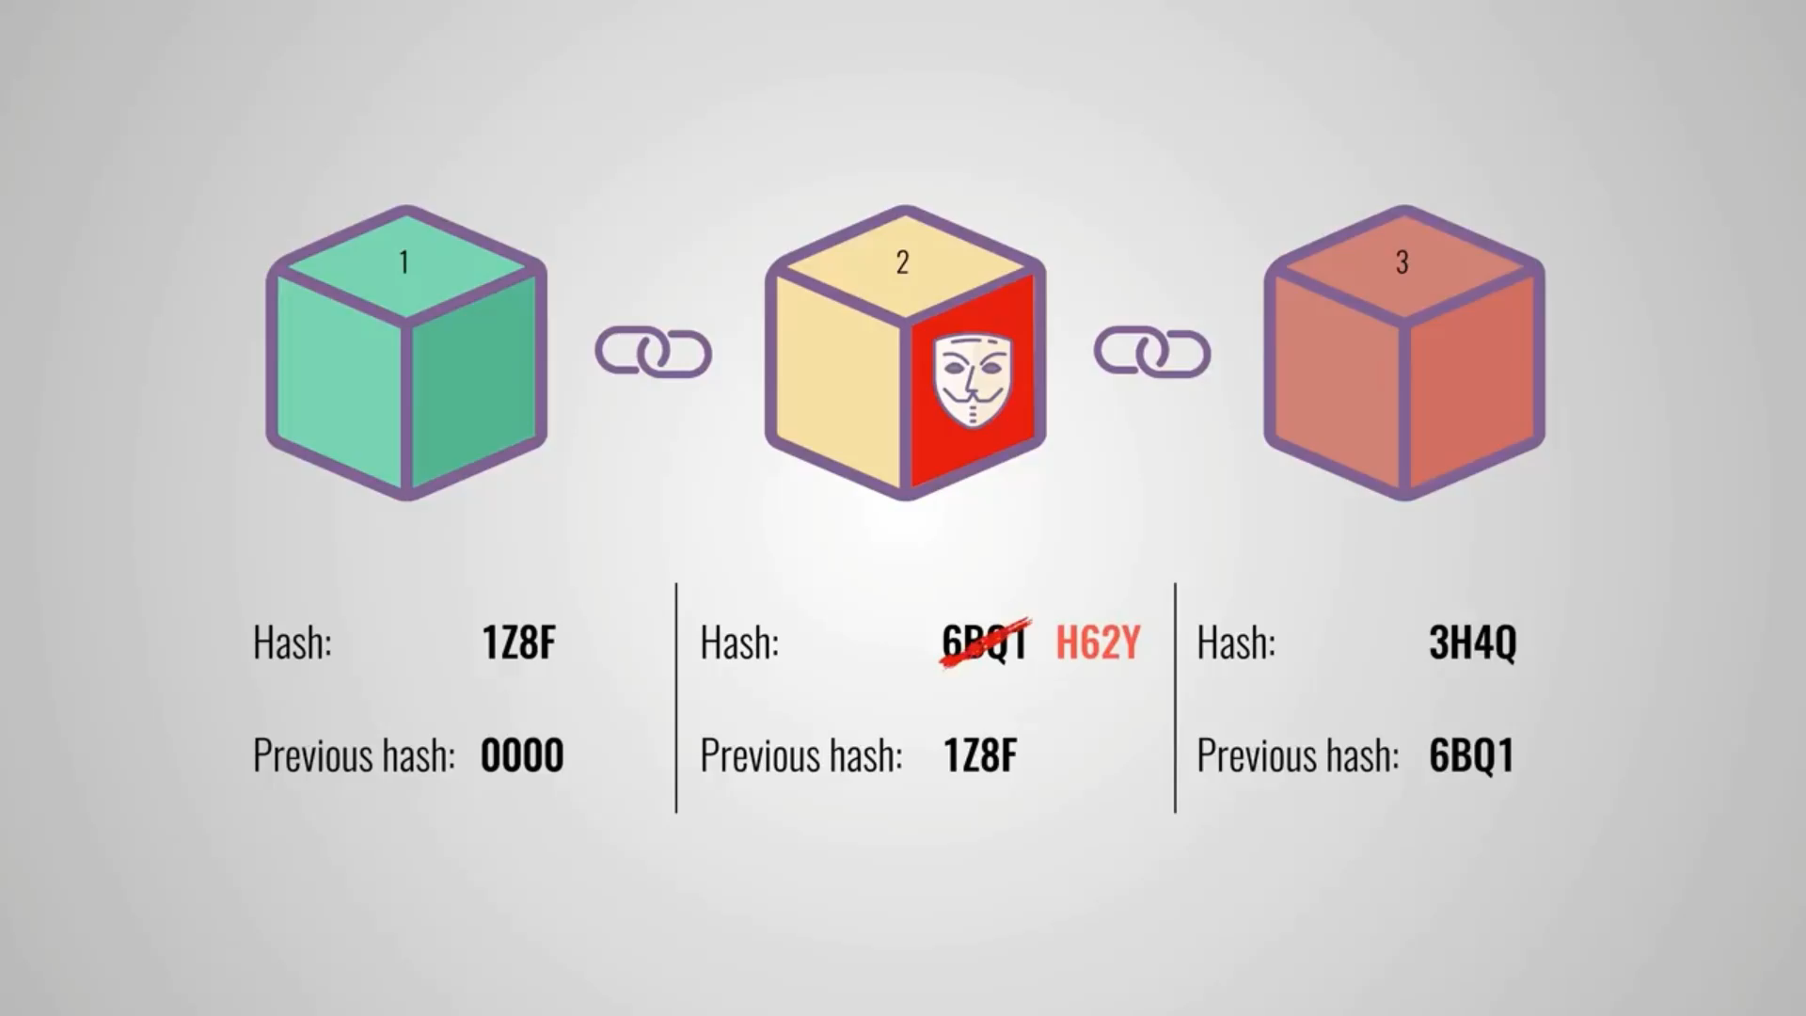
Hash Concept II

Slide 25
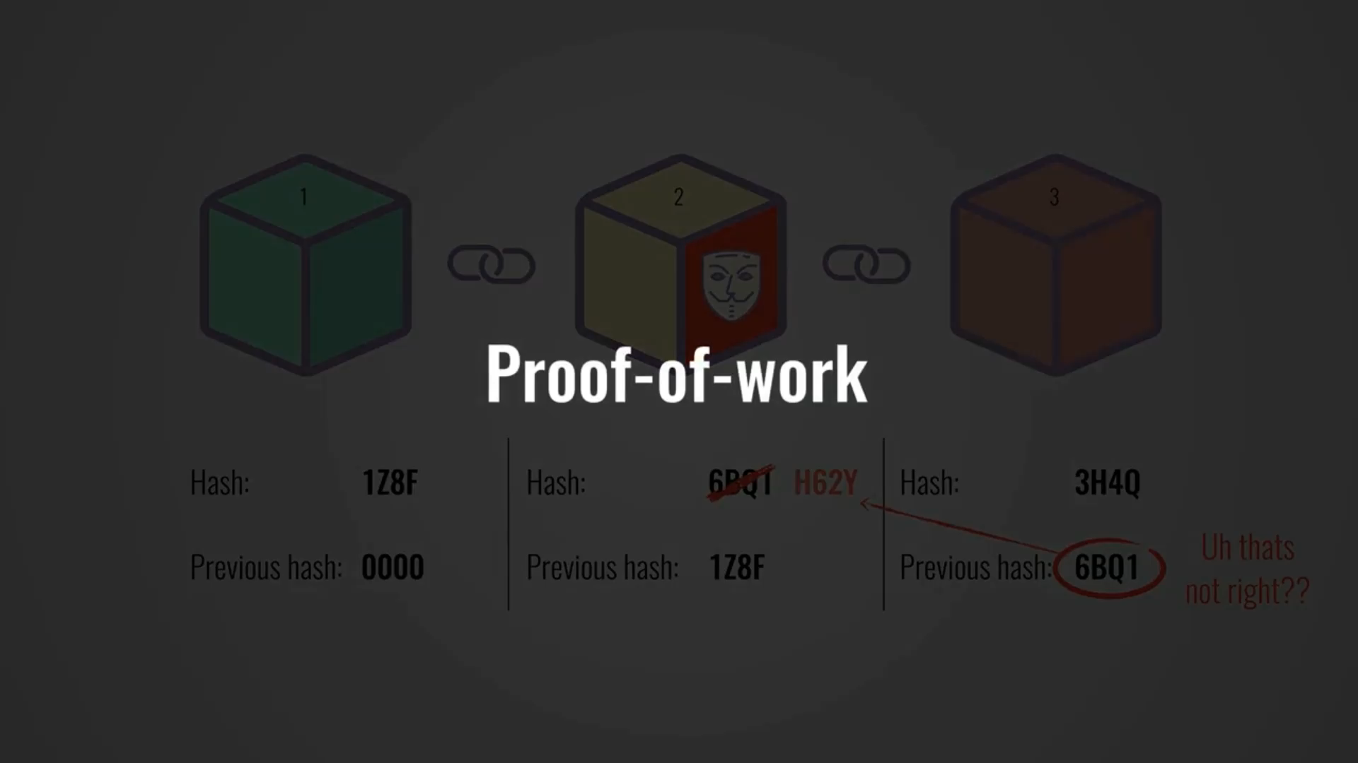
Hash Concept II

Slide 26

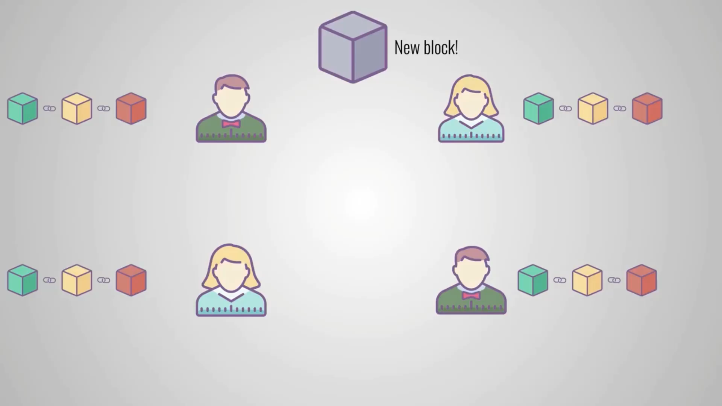














Security

Slide 27
Designing a simple blockchain using R

Slide 28

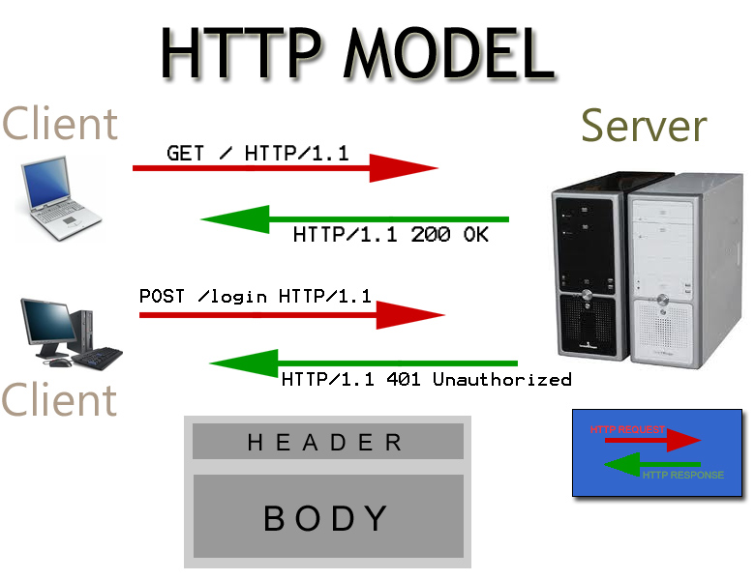

The Blockchain Server

Slide 29
HTTP requests
HTTP is designed to enable communication between clients and servers
It works as a request-response protocol between a client and server.
A web browser may be the client, and an application on a computer that hosts a web site may be the server.

Slide 30
rplumber
Exposes existing R code as a service available to others on the Web.
#* @serializer custom_json
#* @post /transactions/new
function(a){
…
}
Filters and Endpoints are important things to know while using rplumber

Slide 31
Writing your own requests
Download client.R file from repository
Code your requests!
Check the browser for changes introduced

Slide 32
THANK YOU

